Slide 1
International Health Care Management Part 2.3.3
Steffen Fleßa
Institute of Health Care Management
University of Greifswald

Slide 2
2 Demand for Health Services
2.1 Determinants of Demand: Overview
2.2 Demographic and Epidemiologic Transition
2.3 Epidemiology of Infectious Diseases
2.3.1 Background
2.3.2 Example: Malaria
2.3.3 Example: Covid-19

Slide 3
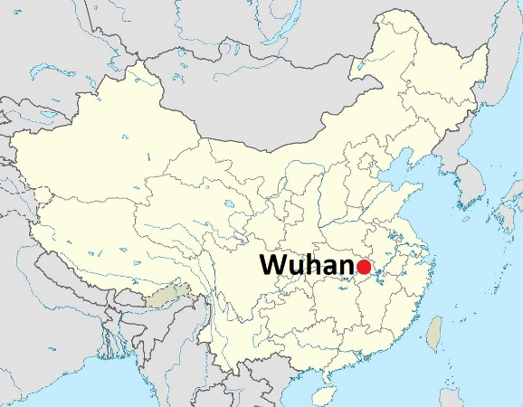
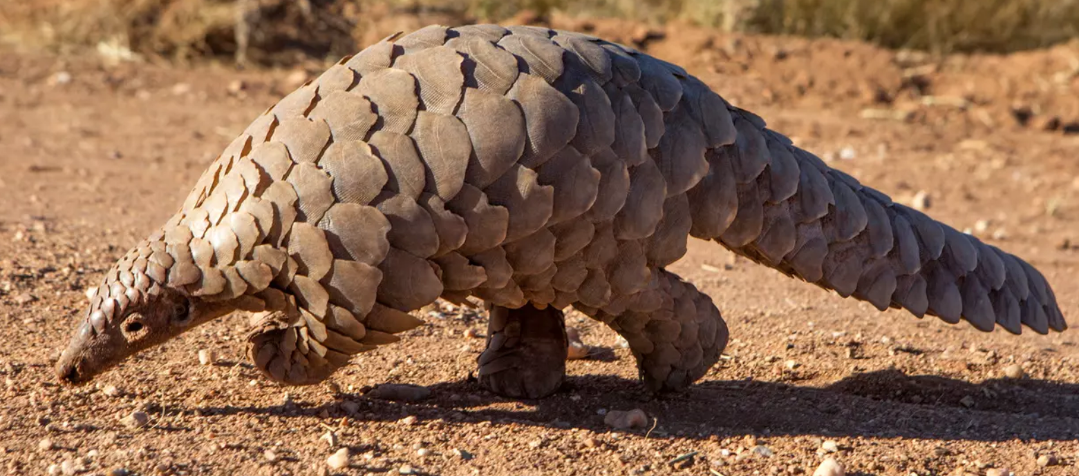
2.3.3 Covid-19
Background
Disease: Corona Virus Disease 2019: Covid-19
Virus: SARS-Cov-2
SARS: Severe Acute Respiratory Syndrome (2002-2003)
Reservoir: most likely bats (intermediate host: Pangolins)
Origin: Wuhan, Hubei province, China
https://www.ifaw.org/de/tiere/pangolin
https://commons.wikimedia.org/wiki/File:Wuhan-location-MAP-in-Hubei-Province-in-China.jpg

Slide 4
Transmission (15.01.20)
https://nextstrain.org/ncov/2020-03-27

Slide 5
Transmission (05.02.20)
https://nextstrain.org/ncov/2020-03-27

Slide 6
Transmission (26.02.20)
https://nextstrain.org/ncov/2020-03-27

Slide 7
Transmission (18.03.20)
https://nextstrain.org/ncov/2020-03-27

Slide 8
https://ourworldindata.org/covid-cases

Slide 9
Covid-19 on Different Continents
https://covid.observer/continents/

Slide 10
Symptoms (0-59 yrs.)
Fever, coughing, pain, fatigue, pneumonia
95 % recover without or with little treatment
5 % need hospital care
93 % normal wards
7 % ICU
33 % recover
67 % die
Case fatality: 0.2 % > 0
https://www.sueddeutsche.de/gesundheit/coronavirus-kinder-1.4859225?utm_source=pocket-newtab

Slide 11
Symptoms (60-79 yrs.)
Fever, coughing, pain, fatigue, pneumonia
80 % recover without or with little treatment
20 % need hospital care
66 % normal wards
34 % ICU
49 % recover
51 % die
Case fatality: 3.5 % >> 0
https://www.sueddeutsche.de/gesundheit/coronavirus-kinder-1.4859225?utm_source=pocket-newtab

Slide 12
Germany
https://ourworldindata.org/grapher/covid-19-total-confirmed-cases-vs-total-confirmed-deaths

Slide 13
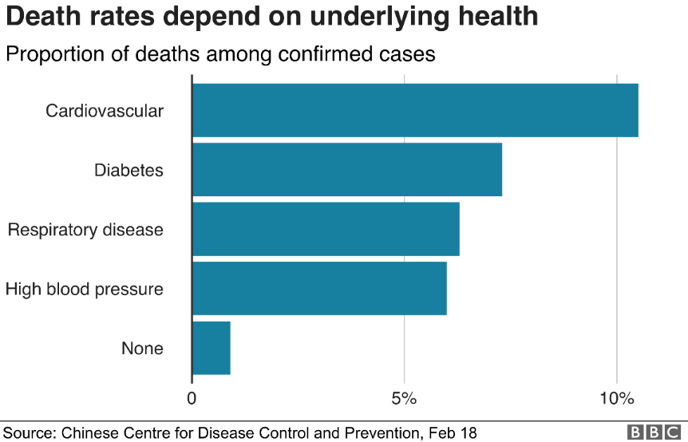
Death rates
https://www.bbc.com/news/health-51674743

Slide 14
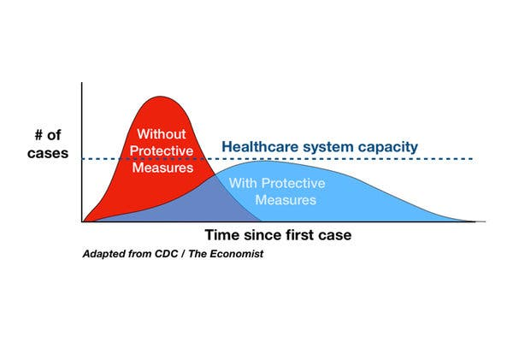
Major problem: ICU beds and ventilation
Example:
80,000,000 pop.
1 % ventilation required = 800,000 pop.
Average ventilation length: 14 days
Alt. 1: all cases in 8 weeks: 200,000 ventilations required
Alt 2: all cases in 32 weeks: 50,000 ventilations required
https://www.nytimes.com/article/flatten-curve-coronavirus.html

Slide 15
Excess Mortality 2020/21
P-Score:
Excess deaths / expected deaths
https://www.nature.com/articles/s41586-022-05522-2

Slide 16
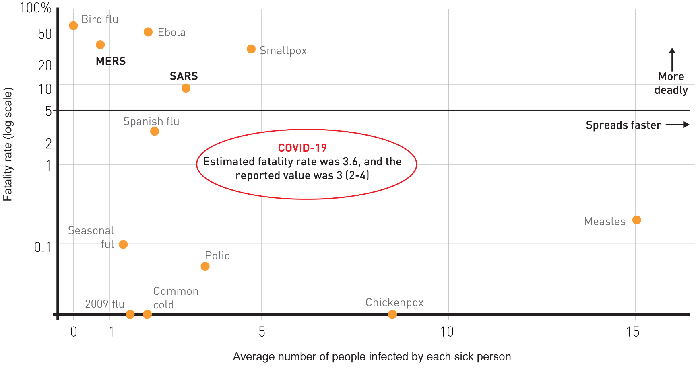
Covid-19: The biggest killer?
SARS-Cov-II Wild Type: R₀ = 2.5-3.5
m=0.5-5.0
https://ophrp.org/journal/view.php?number=548

Slide 17
Covid-19: The biggest killer?
SARS-Cov-II Omikron: R₀ = 5.5-24
m=0.3-4.5
https://ophrp.org/journal/view.php?number=548

Slide 18
Corona in Africa
https://afrika.info/corona/
10.01.23
12.224 Mio. Infections
257,000 death cases
New cases per day
Actives Cases
(1.2.21)

Slide 19
Infection waves in Africa
https://who.maps.arcgis.com/apps/dashboards/0c9b3a8b68d0437a8cf28581e9c063a9

Slide 20
Covid-19 in India
https://www.youtube.com/watch?v=myb8GxLLpT0
https://www.youtube.com/watch?v=pbZLE4WvTg4

Slide 21
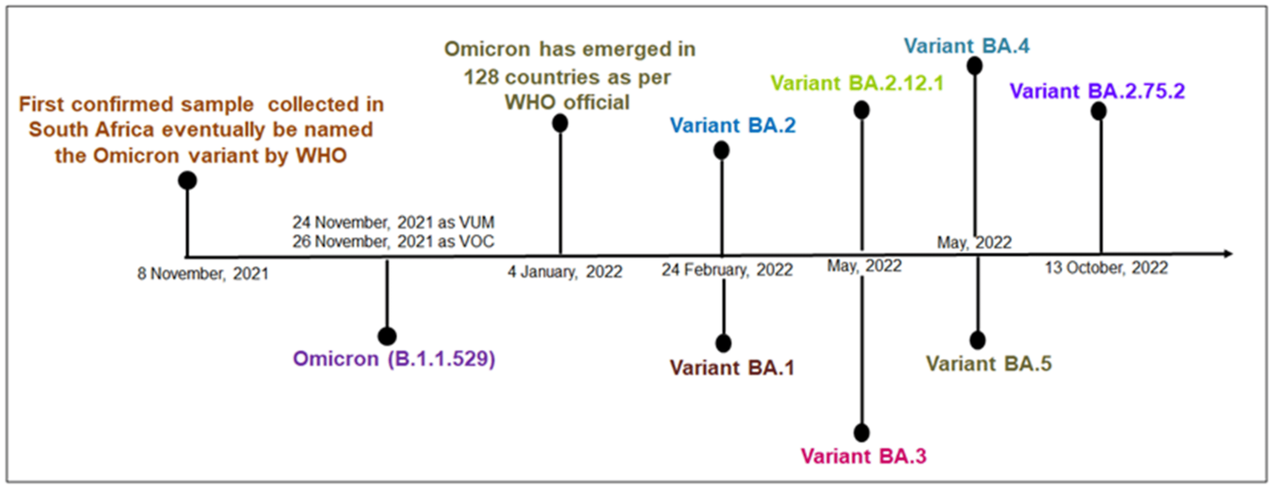
https://www.mdpi.com/1999-4915/15/1/167

Slide 22
Basic Reproductive Rate
Omicron: >8?
https://newsroom.unsw.edu.au/news/health/what-we-know-about-sars-cov-2-delta-variant
Zero-Covid-Strategy: feasible for wild type, not for omicron

Slide 23
Reproductive Rate
Net Reproductive Rate
Reproductive rate if a part of the population is immune (because it survived the disease or was successfully immunized)
$N_{0}=\frac{R_{0}(100−n)}{100}$; $n=100−100\frac{N_{0}}{R_{0}}$ with
n: share of immune population (e.g. vaccination rate)
Covid-19
R₀=3
for N₀<1: n>67 %
R₀=8
for N₀<1: n>87,5 %

Slide 24
Transition Model of Covid-19
Healthy
UV-
radiation
Risk contacts
Infected
Age sructure
climate
Indoor
culture
Social-
Distancing
Infectious
Comorbidity
Air condition
Economics
Immunity
Politics
housing
Symptomatic
Hospital beds
PHC
Vacccination
Constitution
nurses
Hospital
drugs
Other infections
Health Care System
MDs
ICU
Death
ICU beds

Slide 25
Reasons for low incidence
Young population
“outdoor” life
Limited air conditioning
High resistance to infections based on strong immune system
Poor testing and recording

Slide 26
Vaccination
Development of a vaccine
Analysis of virus (what stimulates immune response?)
Design of vaccine (Live, inactivated, subunit and toxoid vaccines)
Testing with animals
Testing with volunteers
Start production
Approval
Start Vaccination programs

Slide 27
Masks
Typology
Community Masks
Medical Masks
White Masks (Surgical Masks)
FFP Masks (filtering facepiece)
FFP2: Aerosol filtration percentage: ≥94%
FFP3: Aerosol filtration percentage: ≥99%
Purpose
Self-protection
Third-party protection

Slide 28
Effectivness
 | Third-party protection | Self-protection
Community Mask | X | -
White Mask | X | ≈
FFP2 | X | X
“Masks do not protect against Covid-19”
Which mask?
Protect who?

Slide 29
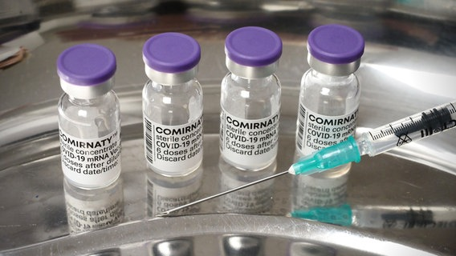
Vaccinations
HEALTHY
INFECTED,
NO SYMPTOMS
Asympto-matic
cases
INFECTIOUS,
LIMITED
INFECTED,
MILD SYMPTOMS
INFECTIOUS,
STRONG
INFECTED,
SEVERE SYMPTOMS
DEATH
THIRD-PARTY PROTECTION
SELF-PROTECTION

Slide 30
Vaccinations
“Vaccines do not help”
Help means what?
Protect against infection?
Protect against severe illness?
Protect against death?
Help who?
Self-protection
Third-party protection

Slide 31
Modelling Covid-19
Healthy
Infection
Incubation
Incubation period
Sick
fatality
Sickness period
Dead
Immune

Slide 32
Variables
H_{t} | Healthy in t
I_{t} | Incubating in t
S_{t} | Sick in t
M_{t} | Immune in t
T_{t} | Death cases in t
m | Fatality rate
s | Sickness period
i | Incubation period
r | Infection rate: probability of getting infected per day if a non-infected encounters an infected

Slide 33
Formulae
$$H_{0}=1000000$$
$$H_{t+1}=H_{t}−\frac{H_{t}}{H_{t}+I_{t}+S_{t}+M_{t}}∙\frac{I_{t}+S_{t}}{H_{t}+I_{t}+S_{t}+M_{t}}∙H_{t}∙r$$
$$I_{t+1}=I_{t}+\frac{H_{t}}{H_{t}+I_{t}+S_{t}+M_{t}}∙\frac{I_{t}+S_{t}}{H_{t}+I_{t}+S_{t}+M_{t}}∙H_{t}∙r−\frac{I_{t}}{i}$$
$$S_{t+1}=S_{t}+\frac{I_{t}}{i}−S_{t}∙m−\frac{S_{t}}{s}$$
$$T_{t}=S_{t}∙m$$
$$M_{t+1}=M_{t}+\frac{S_{t}}{s}$$

Slide 34
Basic results
Definition | Variable | Parameter | Explanation
fatality | m | 0.05 | share of population dying in the sickness period
original population | H₀ | 1,000,000 | population in t=0
sickness period | s | 14 | days
infection rate | r | 0.5 | propability that a non-infected is infected by encountering an infected per day
incuation period | i | 14 | days

Slide 35
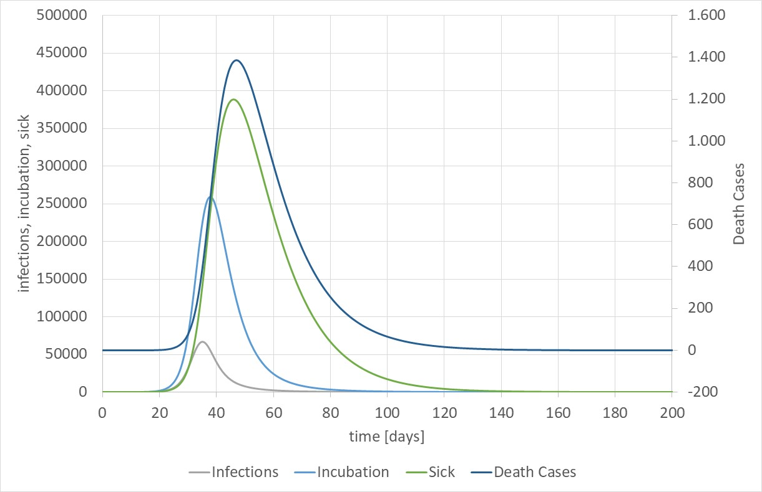

Slide 36
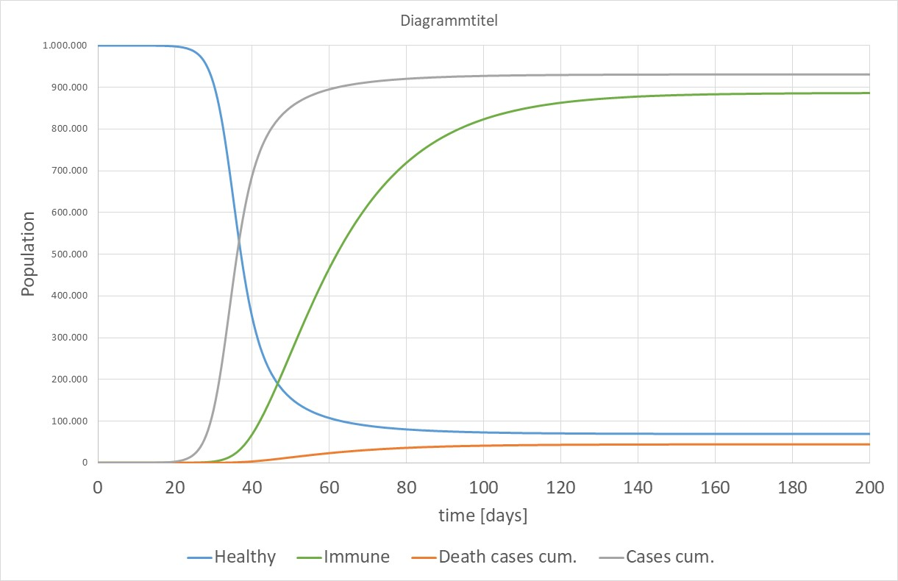

Slide 37
Fatality Rate

Slide 38
Variation of sickness period

Slide 39
Variation of incubation period

Slide 40
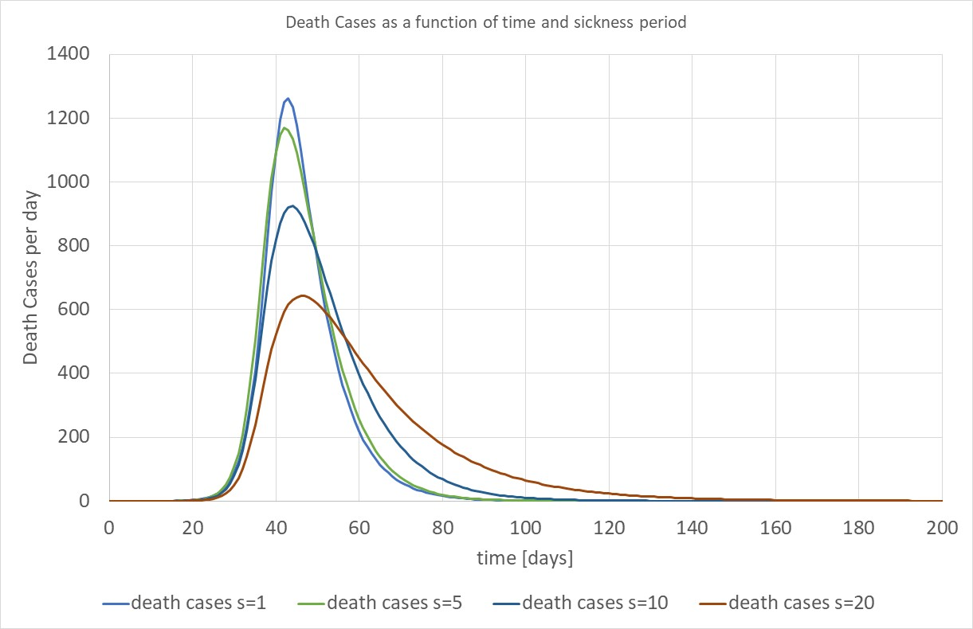
Death cases and sickness period

Slide 41
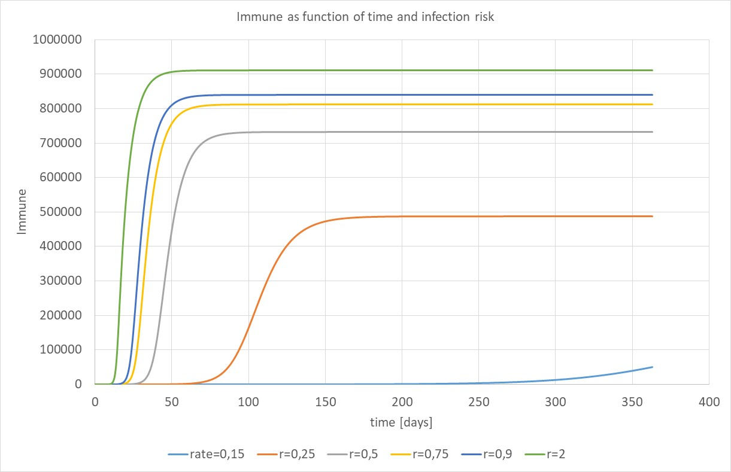

Slide 42
Second Wave
Scenario I: no intervention R₀=2.5
Scenario II: long-term intervention R₀=2.5→0.95
Scenario III: complete relaxation R₀=2.5→0.95→2.5
Scenario IV: soft relaxation R₀=2.5→0.95→1.5

Slide 43
2 Demand for Health Services
2.1 Determinants of Demand: Overview
2.2 Demographic and Epidemiologic Transition
2.3 Epidemiology of Infectious Diseases
2.3.1 Background
2.3.2 Example: Malaria
2.3.3 Example: Covid-19

